Slide 1
PLC Basic Training
Control Subteam
Ziyan Zhang
Fall 2016

Slide 2
Reference
Kelvin T. Erickson - Programmable Logic Controllers: An Emphasis on Design and Application

Slide 3
Outline
1. Introduction to PLCs
2. Basic Ladder Logic Programming
3. Tags and Data Type
4. Timers and Counters
5. Comparison and Computation
6. Real Program for Testbed (Optional)

Slide 4
Introduction to PLCs
What is PLC?
Programmable logic controllers
Workhorses of modern manufacturing automation
Automation Control System
Input Sensors
Programmable Logic
Controller
Output Actuators
Measurement
Resultant
Actions
Process

Slide 5
A little bit more…
Initial concept was develped in 1968
Industrial enviroment, more reliable, easily maintained, quick power failure recovery, sequential execution order, etc.
PLC within automation system
Process
PLC
Parts
bin
Outputs:
Motors
Solenoids
Robot
arm
Processor
Input/Output
Modules
CNC
drill
Inputs:
Limit switches
Proximity
Conveyor
Pick-up
point
Programming Terminal

Slide 6
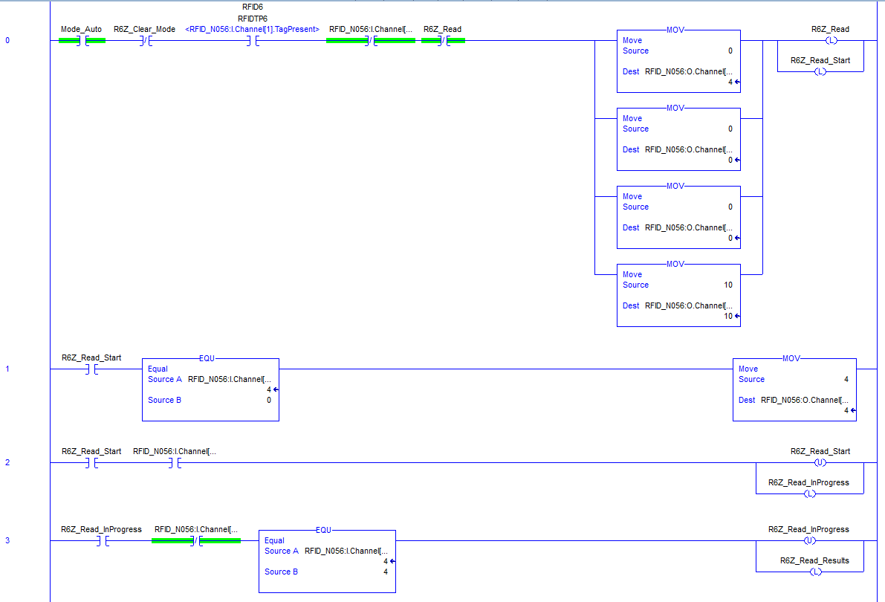
Basic Ladder Logic Programming
Ladder logic - the first and still most popular programming language for PLC

Slide 7




Basic ladder logic symbols (Studio 5000Logix Designer)
Normally Open contact
Passes power (on) if it is closed (on)
Normally Closed contact
Passes power (on) if it is open (off)
Output or Coil
If any left-to-right rung path passes power, it is energized (on). If no continuous left-to-right rung path passing power, de-energized (off)

Slide 8



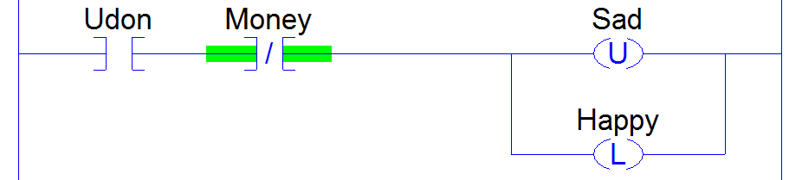
Latch Coil
If any rung path passes power, it is energized and remain energized, even when no rung path passes.
Unlatch Coil
If any rung path passes power, it is de-energized and remain de-energized, even when no rung path passes.

Slide 9
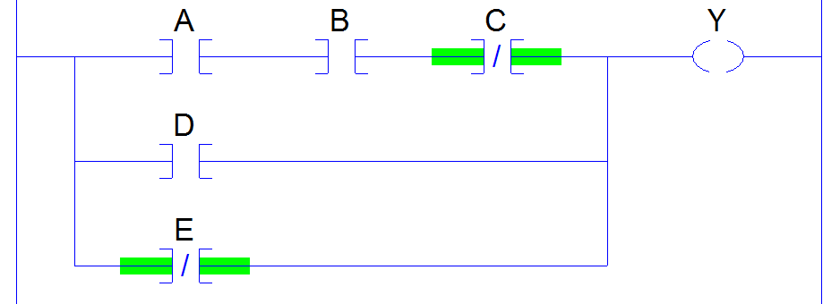
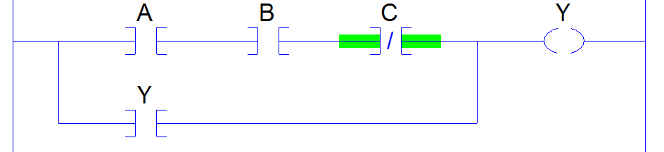
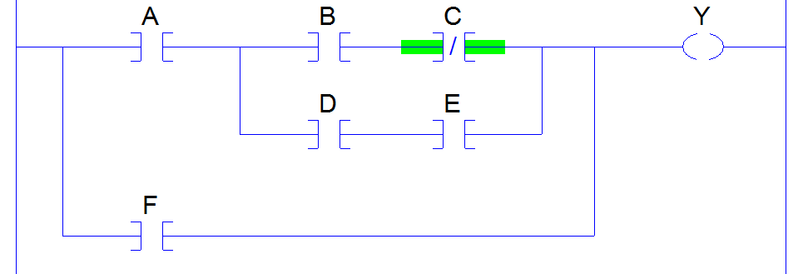
Y = ABC + D + E
1. DO NOT repeat normal output
coils or latch/unlatch
2. Use latch coil and unlatch coil
together

Slide 10
Tags and Data Type
User defined tags
BOOL
SINT
COUNTER
TIMER
1. The first character is not a digit
2. There are not two more consecutive underlines
3. The last character is not an underline
User defined tags
1-bit Boolean, 0 = cleared, 1= set
1-byte integer, -128 to 127
Later in counter instruction
Later in timer instruction

Slide 11
Tags and Data Type
Input/Output tags
RFID_N056:I.Channel[0].Busy (BOOL)
RFID_N056:O.Channel[1].Data[10] (SINT)
Digital Input
Representing
RFID Transceiver 5 Physically
RFID Interface Module
(Dual Channel)

Slide 12
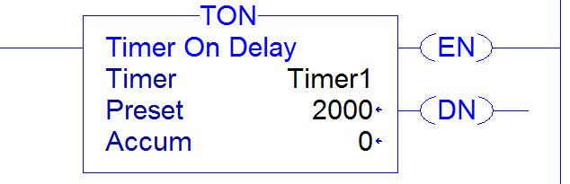
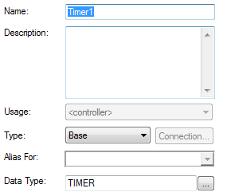
Timers and Counters
TON On-Delay Timer
When the timer input is on, the accumulator is counted up once each millisecond. When the accumulator equals the preset value, the timer is “timed out” and the .DN bit is set to on. If the timer input turns off during the timing interval, the accumulator is set to zero and timing recommences when the input turns on.

Slide 13
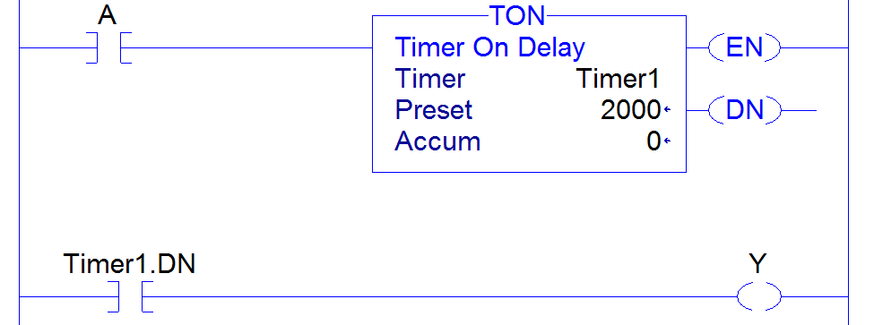
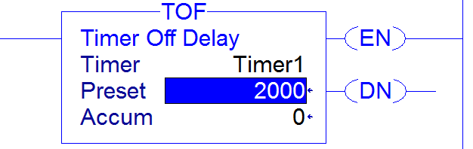
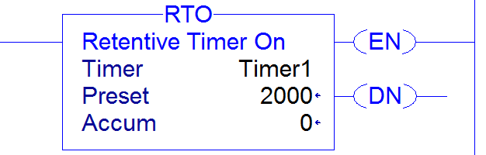
TOF Off-Delay Timer
RTO retentive On-Delay Timer

Slide 14
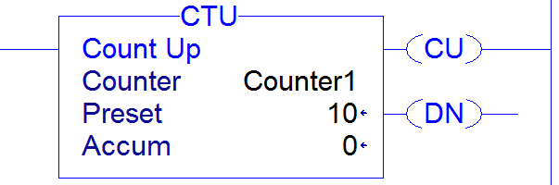
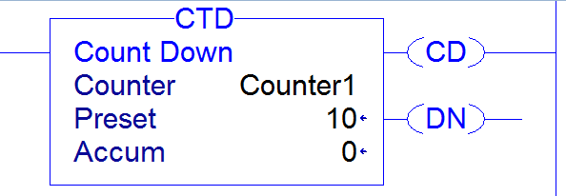
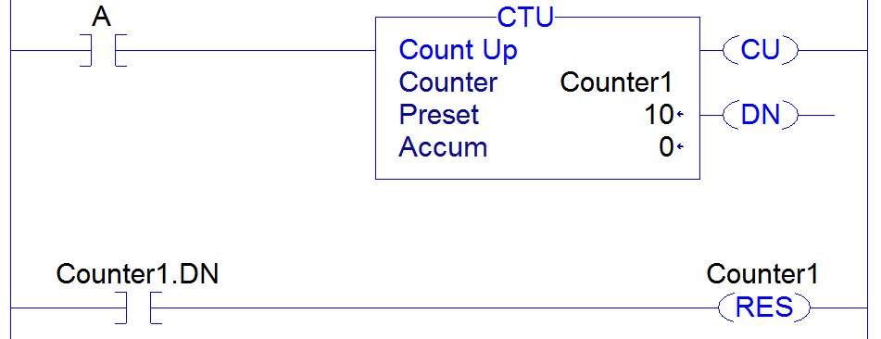
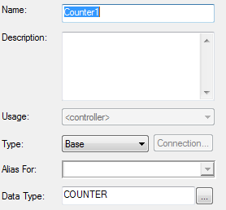
CTU Up Counter or CTD Down Counter
For the CTU or CTD, the counter accumulator increments/decrements by one for every off-to-on transition of the counter input.

Slide 15
Comparison and Computation
Head to lab computer and show

